Slide 1
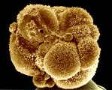
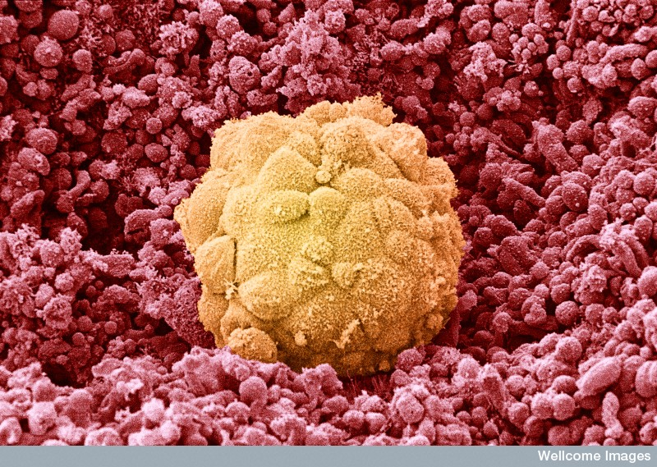
6 day old Blastocyst implanting into the endometrium
3-4 day old Morula

Slide 2
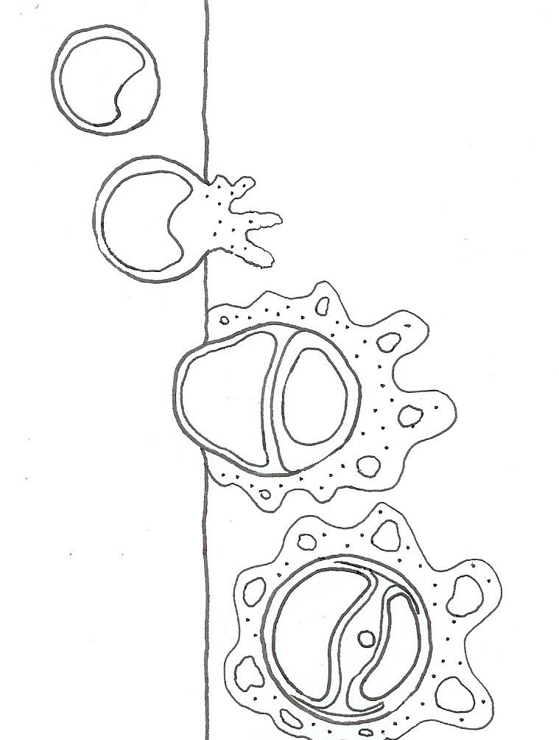
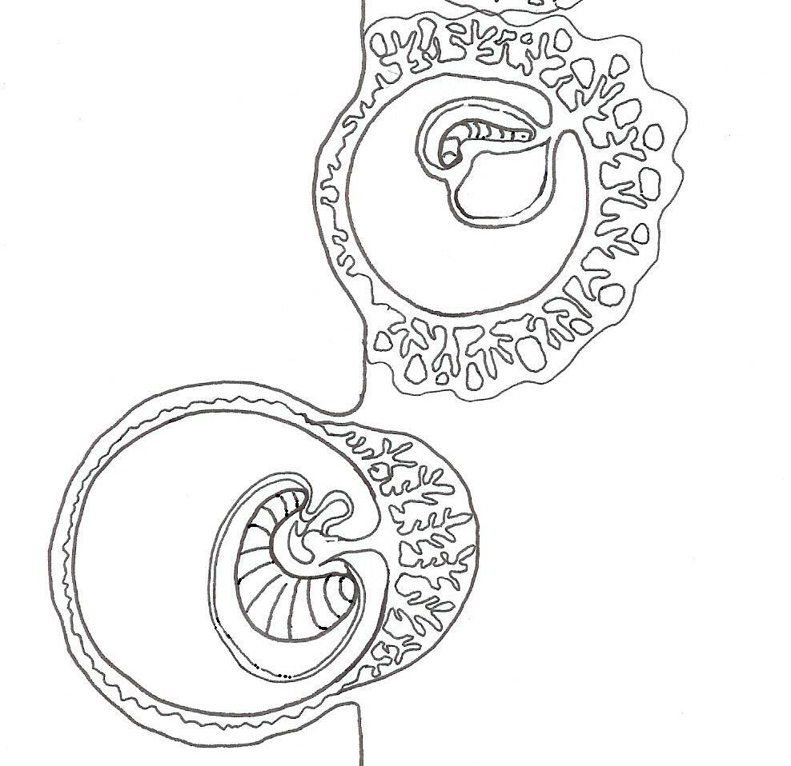
Implantation & development of the placenta
Blastocyst Day 7
Week 3
ENDOMETRIUM
Inner cell mass
Inner cell mass
Developing villus
Day 9
Yolk sac
Blastodisc
Week 4
Developing placenta
Day 14
ENDOMETRIUM

Slide 3
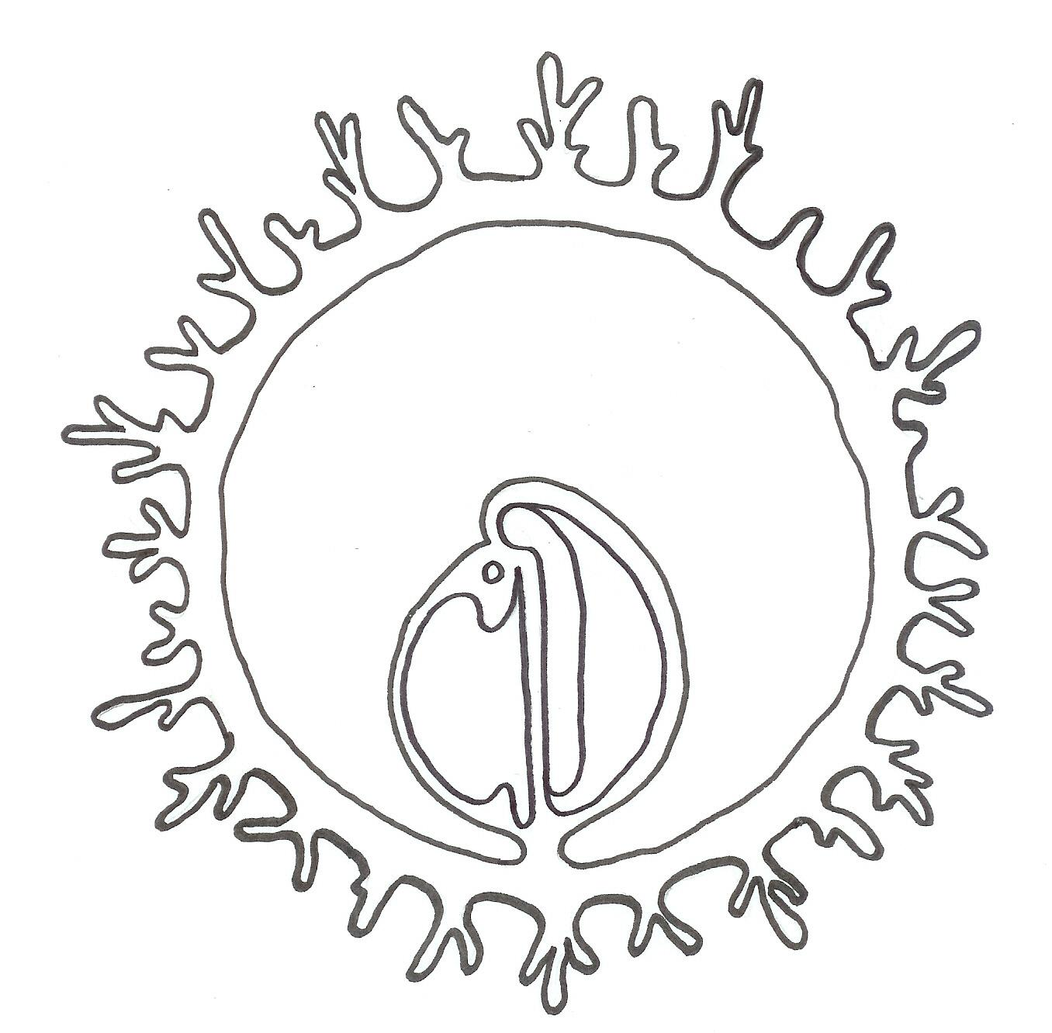
Embryonic membranes
Chorion
Amnion
Embryo
Yolk sac
Allantois

Slide 4
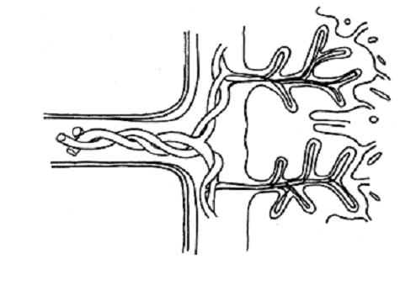
The structure of the placenta
Chorionic villi
Umbilical cord
Space filled with mother’s blood
Mother’s blood vessels
Umbilical arteries
Umbilical vein
Baby’s blood vessels

Slide 5
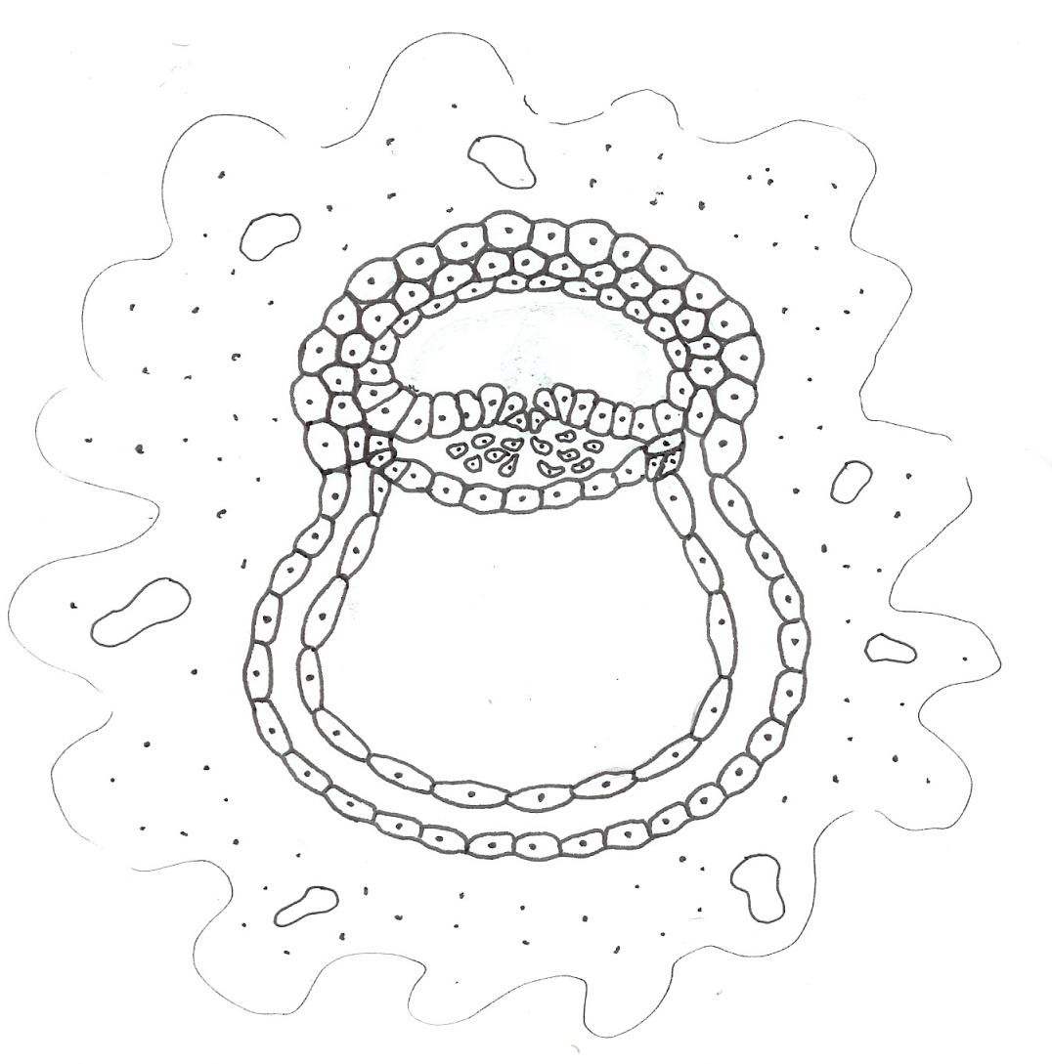
Structures derived from the primary germ layers
Ectoderm Skin, hair etc. Nervous tissue Lining of respiratory & digestive systems
Endoderm pancreas, liver, bladder, thymus & thyroid gland
Mesoderm Skeletal, muscular, cardiovascular, lymphatic, urinary & reproductive systems

Slide 6
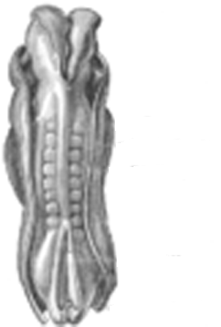
Embryo 21-23 days
Yolk sac
Primitive segments
Neural folds
Gray’s Anatomy

Slide 7
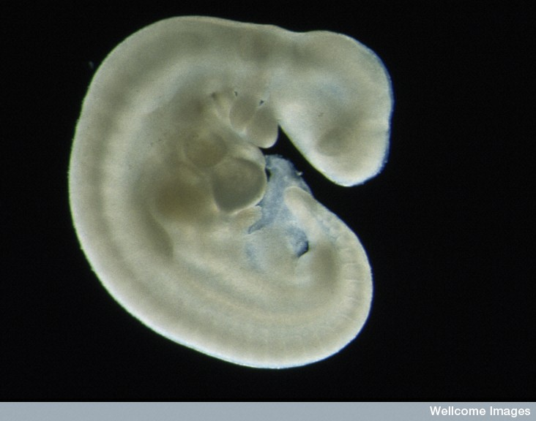
Four week old Human Embryo
Eyes
Limb buds
Segmented body
Tail
Wellcome Photo Library, Wellcome Images

Slide 8
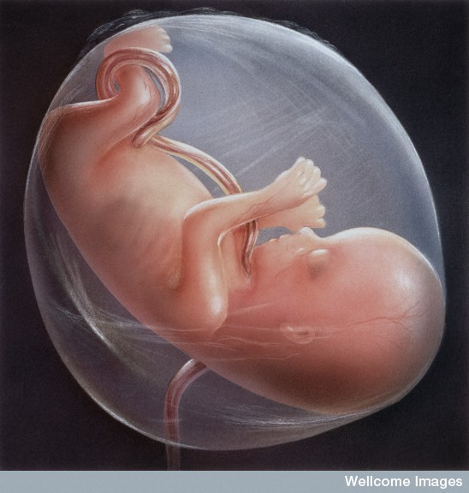
Foetus at 8-9 weeks
Mainly a period of growth
Over 90% of the adult body structures are already established and can be recognised.

Slide 9
The mother in the first trimester
Signs of pregnancy in the 1st trimester include:
Menstruation stops
Morning sickness ( in about 75% of cases)
Swollen and tender breasts
Tiredness
Giddiness
Increased frequent of urination.

Slide 10
The mother in the 2nd & 3rd trimester
In the second trimester the mother feels the first movements of the child.
The abdomen starts to become noticeably larger after about the 5th month.
Other signs are likely to include:
Weight gain
Backache
Frequent urination
Edema (swelling due to fluid retention)
Constipation.

Slide 11
Physiological changes
During the course of a pregnancy a woman will experience:
Above normal levels of progesterone & estrogen
A blood volume increases of almost 50%
Increased functioning of the heart, kidneys and respiratory system
Risk of gestational diabetes
Risk of increased blood pressure.

Slide 12
Premature babies
Babies born before the 35th week of the pregnancy are termed premature.
Babies can survive if born as early as the 23rd week. These babies typically weigh between 0.6-1.0 kg and have a 50% chance of surviving.
The organ systems of premature babies are still not fully developed, which can result in breathing problems and neurological damage.

Slide 13
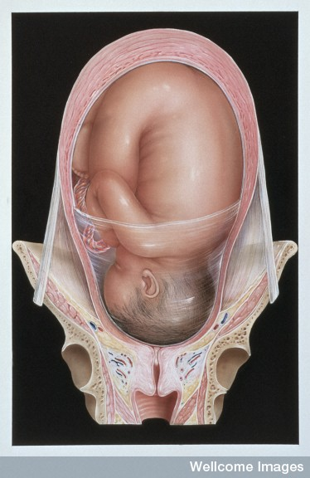
Baby in delivery position
Three stages of labour
Dilation
Delivery
Afterbirth

Slide 14
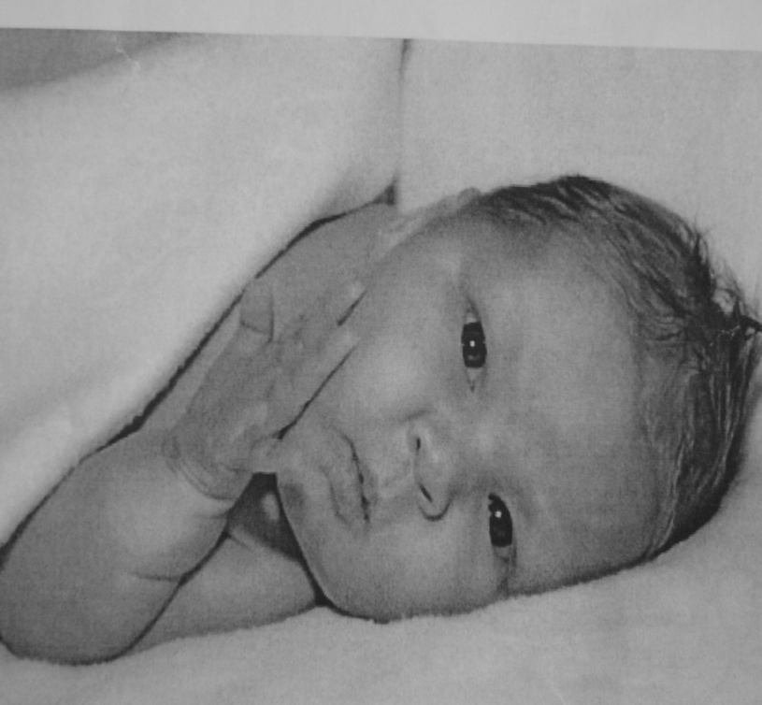
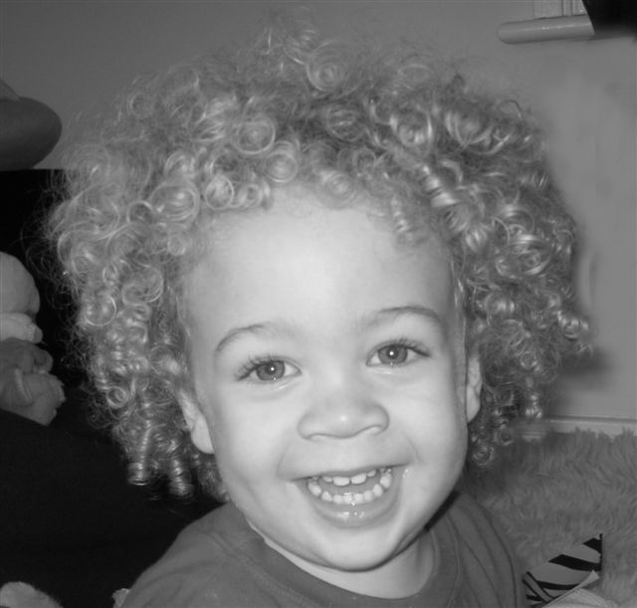
Infancy
Infancy is the earliest stage of life. An infant is usually regarded as a child before they can walk – generally between 12 and 18 months.

Slide 15
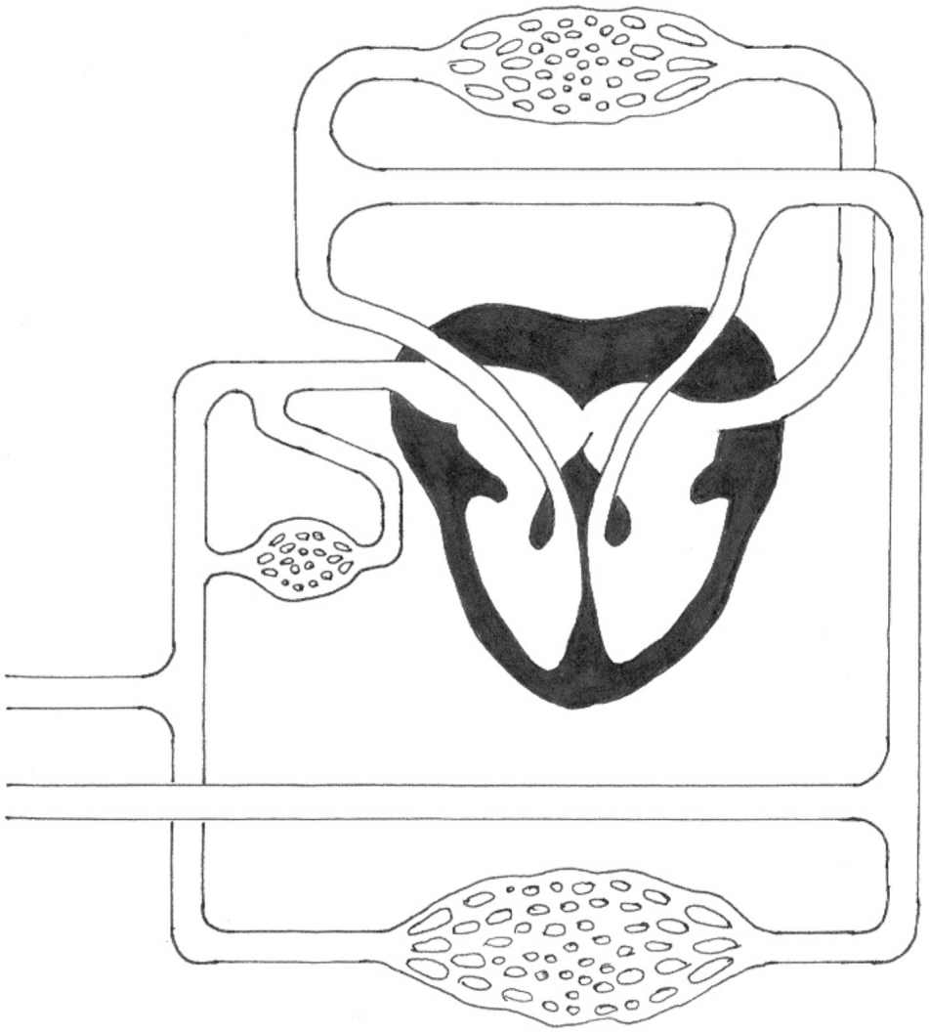
Changes in the circulation
Ductus arteriosus
Foramen ovale
Ductus venosus
Umbilical arteries and vein

Slide 16
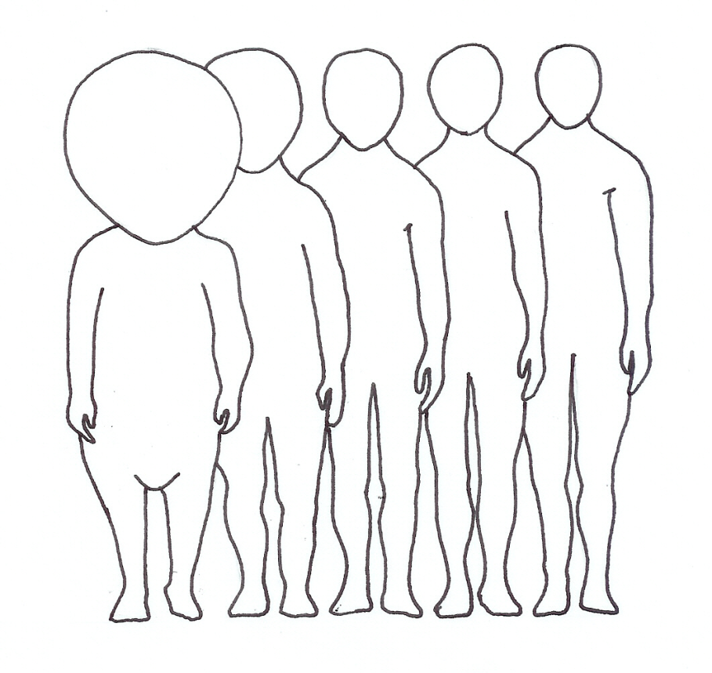
Body proportions change with age
%
100
80
Proportion
of body
size
60
40
20
Age
(yr)
0.5
3
7
13
18

